Slide 1
Hack with
CHECK24
Daniele Cinquantini
Head of Department Software Development

Slide 2
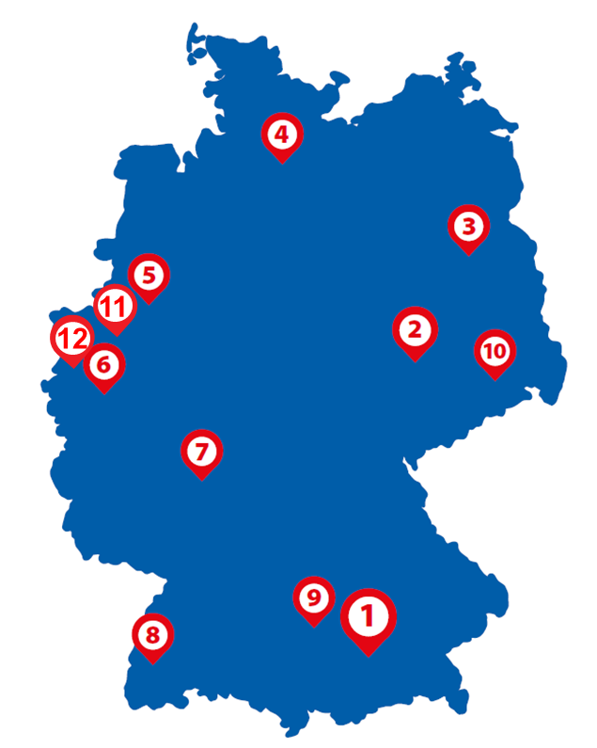
CHECK24 – an IT company
Leading comparison portal in Germany
Our values: be a digital leader, be agile, initiate change, enhance the speed
Over 40 different products
~1000 employees in Munich
~300 developers in Munich
Fast growing by remaining agile
12 locations
Plenty of career opportunities
Many company-sponsored fun activities and events

Slide 3




CHECK24 – A tech oasis
Strong startup mentality anchored in the company DNA
Over 300 developers
Small companies focusing on one product
Own IT, Product Management, Managing Director
Each IT-team focuses on one product, works in an agile environment and applies technologies that suit the products’ needs
Further inhouse education: tech-talks, seminars, coding dojos, hackathons, external lectures, wiki, meetups and many other knowlege management platforms
Interconnectivity of all products over API and other interfaces
All leading technologies, a variety of tech stacks

Slide 4
Your hackaTUM Challenge

Slide 5
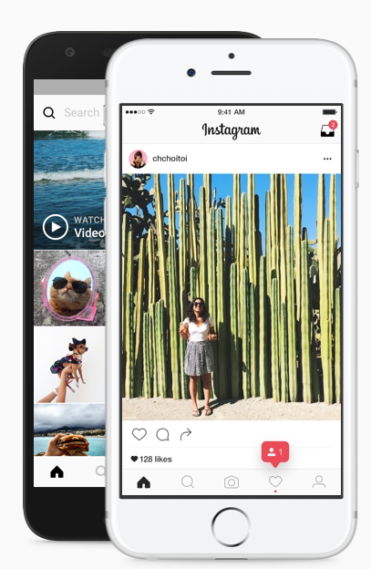







Idea: Find hotels at your dream locations easily!
Social Media
Photos of beautiful landmarks, sights & locations
Wow this is beautiful!!
I wanna go there!
Where is that?
How much do hotels nearby cost?
Are there free rooms available?
Websites
TV & Ads

Slide 6

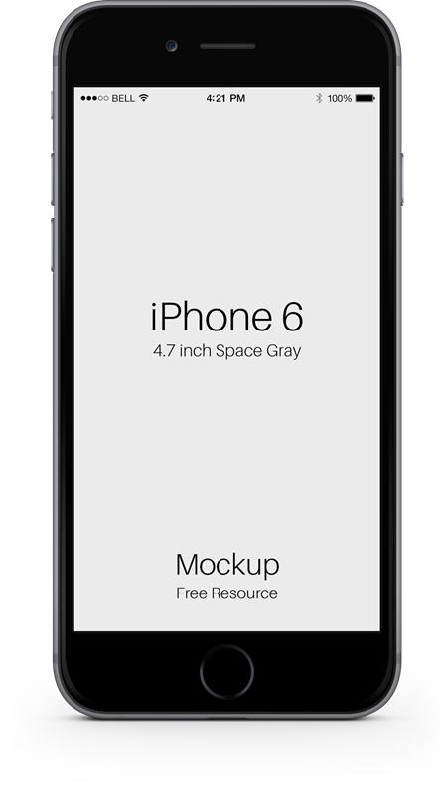


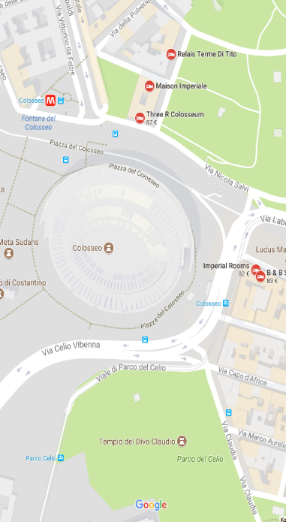
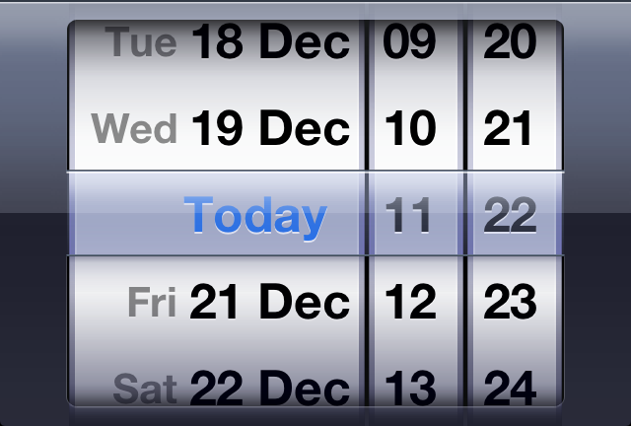
Workflow
41.890251, 12.492373
Rome, Italy

Slide 7
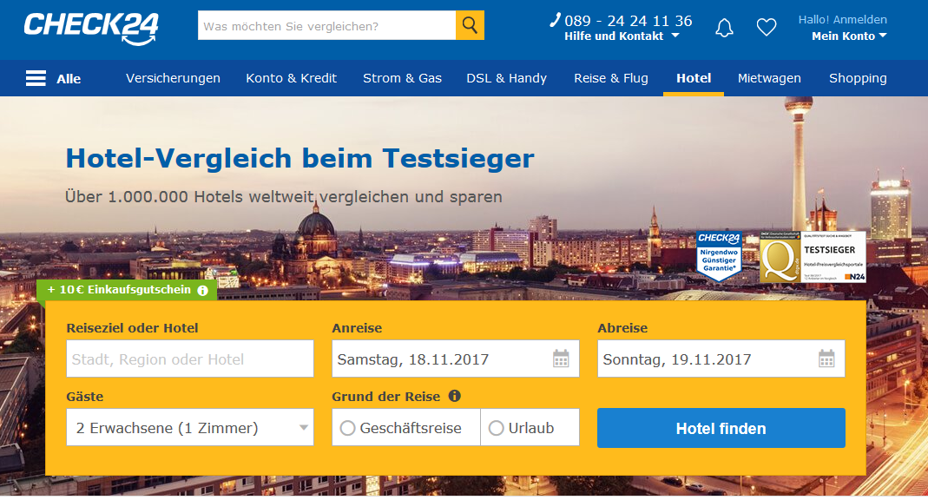
Technical resources
Google API (account will be handed out) in order to recognize the picture
CHECK24 Hotel API
Otherwise the APIs and sources of your choice

Slide 8
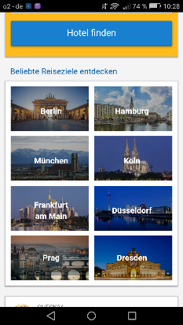
Technical requirements
Technology of your choice
Must work in a web browser
User must see the available hotels nearby
Should work on a smartphone and access the camera
Should have some hotel filter opportunities
Optional: responsive design
Optional: implementation on a map
Optional: show the weather forecast for the location
Optional: use another location source based on the special interest of the person using your application
Last but not least: Must!!! Implement the features of your dreams

Slide 9


What we brought for you?
Access to Google’s closed beta API
Access to our CHECK24 Hotel-API

Slide 10

This could be your price

Slide 11
Any
Questions?

